Slide 1
Standard Deduction Qualified Business Income Deduction
Pub 4012 – Tab F
Pub 4491 – Lesson 20
Notes:
1
Release 2 notes:
#7 Clarified additional standard deduction amount
#13 Clarified that adjustments or deductions do not affect the QBI deduction
#14, 17 Corrected calculation and clarified that net capital gains includes qualified dividends for the QBI deduction computation

Slide 2
Deductions
Subtractions from a taxpayer’s adjusted gross income (AGI)
Reduces amount of income taxed
Most taxpayers have a choice
Standard deduction
Itemizing deductions
Use deduction that results in lower tax

Slide 3
Standard Deduction
Standard deduction is a fixed reduction of AGI based on:
Filing status
Age (65 or older)
Blindness
Dependency
Standard amounts change each year
Automatically calculated based on TaxSlayer entries
3
Notes:
Check filing requirements for MFJ (JOINT) when couple did not live together at end of year. Standard deduction and filing requirements are NOT the same.

Slide 4
Standard Deduction – TY 2018
2018 standard deduction increased for all filers
Single or Married Filing Separately – $12,000
Married Filing Jointly or Qualifying Widow(er) – $24,000
Head of Household – $18,000
Personal exemption deduction suspended for 2018 through 2025
Notes:
Check filing requirements for MFJ (JOINT) when couple did not live together at end of year. Standard deduction and filing requirements are NOT the same.

Slide 5
Cannot Claim Standard Deduction
Filing as MFS
If either itemizes – both must itemize
Does not matter who files first
Note: if considered unmarried for Head of Household, may claim standard deduction
Notes:
If second to file chooses to itemize and first to file choose standard, first to file must amend his/her return to itemize deductions
5

Slide 6
Blindness
Totally blind taxpayer or
Certified statement from eye doctor that
Taxpayer cannot see better than 20/200 in the better eye with glasses or contact lenses or
Field of vision not more than 20 degrees
Notes:
Not necessary for taxpayer to produce this certified statement – remind them of need to prove if asked and accept their verbal statement - it’s their return

Slide 7
Standard Deduction for Dependents
Pub 4012 Tab F
Dependent of another
Standard deduction is $350 plus earned income
Minimum: $1,050
Maximum: the regular standard deduction amount
Plus $1,600 for 65 or older or blind Single or HoH ($1,300 if MFJ, MFS, QW)
Notes:
Refer to Pub 4012 F-1 for the regular standard deduction amounts
Good worksheet in Pub 4012 this year for dependent’s standard deduction

Slide 8
Standard Deduction for Nonresident Aliens
Pub 519 Chapter 1
Dual status alien or a nonresident alien
May not be eligible for standard deduction
International certification required

Slide 9
Quality Review
Verify blind (and disability if relevant to your state) entries in Intake Booklet
Verify type of deduction if MFS
Verify dependent’s standard deduction amount

Slide 10
Standard Deduction

Slide 11
Qualified Business Income Deduction
Individual taxpayers can deduct up to 20% of qualified business income (QBI)
A deduction from AGI to arrive at taxable income
In addition to standard or itemized deductions
New for 2018 and in scope
Also referred to as Section 199A deduction
Notes:
Also referred to as Section199A Business Income Deduction

Slide 12
Qualified Business Income
Schedule C income (combined if more than one)
Pass-through entity business income
Such as partnerships, S corporations, limited liability companies
All pass-through entities with business income are out of scope
Real Estate Investment Trust (REIT) 199A dividends
Scope: if taxable income (before the QBI deduction) exceeds $157,500 ($315,000 if MFJ) the return is out of scope
Special rules apply if threshold is exceeded – out of scope
Other scope limitations may kick in at lower income limits
Notes:
New box 5 1099-DIV for section 199A dividends eligible for QBI

Slide 13
QBI Deduction Implications
Schedule C is not affected
Self-employed health insurance deduction* is not affected
IRA deduction* is not affected
Schedule SE tax* and ½ SE tax deduction* are not affected
* And, these items do not affect the QBI deduction

Slide 14
Calculating QBI
Pub 4012 Tab F
20% of the lesser of
Combined qualified business income (for in-scope returns)
Schedule C profit (as shown on Schedule C)
plus qualified REIT dividends (section 199A dividends)
Form 1099-DIV has a new box 5 for 199A dividends
Taxable income in excess of any net capital gain* and before the QBI deduction
Find QBI deduction in Pub 4012 Tab F for TaxSlayer entries
* The term “net capital gain” means the excess of the net long-term capital gain for the taxable year over the net short-term capital loss for such year increased by qualified dividends
Notes:
See Pub 4012 Tab F for TaxSlayer entries

Slide 15
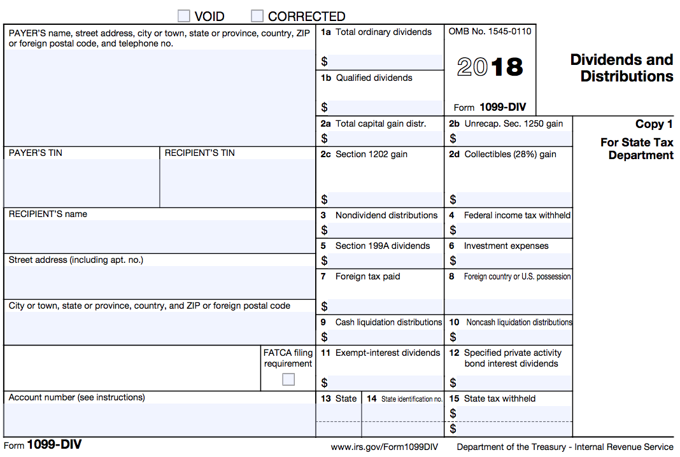
REIT and Qualified Business Income

Slide 16
QBI Deduction Example 1 without Capital Gain
2018 Schedule C profit (QBI): $10,000
2018 taxable income (before QBI deduction): $8,100
QBI deduction is 20% of the lesser of:
Schedule C profit (QBI) $10,000 or
Taxable income (before the QBI deduction) $8,100
$8,100 x 20% = $1,620
Notes:
Also referred to as Section199A Business Income Deduction
Remember: Subtract net capital gain from taxable income before calculating QBI deduction

Slide 17
QBI Deduction Example 2 with Capital gain
2018 Schedule C profit (QBI): $10,000
2018 taxable income (before QBI deduction): $8,100
$700 of $8,100 is net capital gain income (incl. qualified dividends)
QBI deduction is 20% of the lesser of
Schedule C profit (QBI) $10,000 or
Taxable income in excess of net capital gain income (and before QBI deduction) $8,100 - $700 = $7,400
$7,400 x 20% = $1,480
Notes:
Also referred to as Section199A Business Income Deduction

Slide 18
QBI Deduction Quality Review
Review Schedule C for QBI
Review REIT for box 5 section 199A dividends
Verify Form 1040 QBI calculation
Confirm QBI threshold not exceeded

Slide 19
QBI Deduction

